Slide 1
Analog & Digital Communication Systems
Week 4

Slide 2
Recap
Power signal examples
Classification of signals
Continuous time and discrete time signals
Analog and digital signals
Periodic and aperiodic signals
Energy and power signals
Deterministic and probabilistic signals
Signals operations
Time shifting
Time scaling
Time inversion

Slide 3
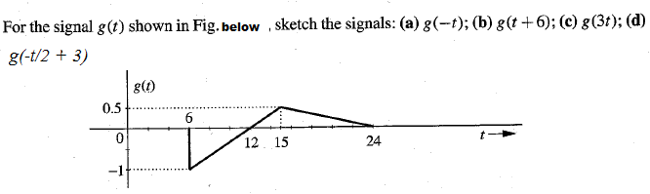
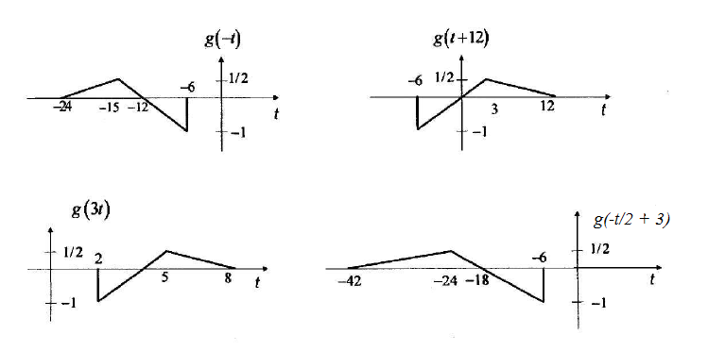
Signals operations Examples
Example
Solution

Slide 4
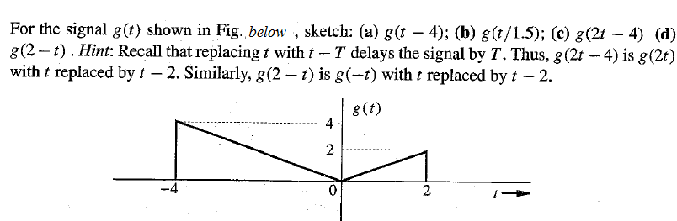
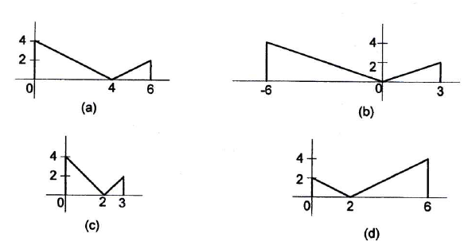
Signals operations Examples
Example
Solution

Slide 5
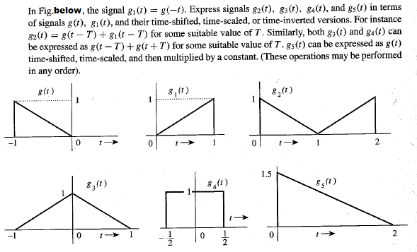
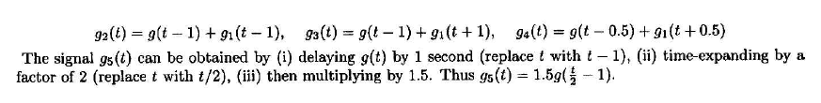
Signals operations Examples
Example
Solution

Slide 6
Unit Impulse Signal
The unit impulse function was first defined by P. A. M. Dirac (hence often known as the “Dirac delta”).
It is infinitesimally narrow, infinitely tall, yet integrates to one.
Simplest way to visualize this as a rectangular pulse from a -D/2 to a +D/2 with a height of 1/D of unit area.
The impulse function is written as

Slide 7

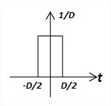
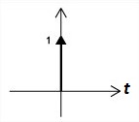
Unit Impulse Signal
=0 for all t ≠ 0

Slide 8
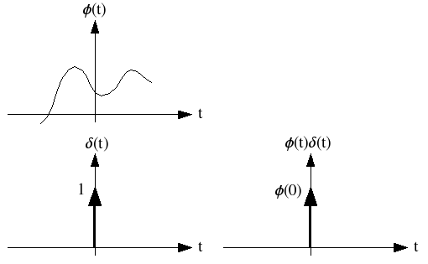

Unit Impulse Signal
Multiplication of a Function by an Impulse
If a function g(t) is multiplied by unit impulse function we get impulse value of g(t) at t = 0, which is g(0).

Slide 9
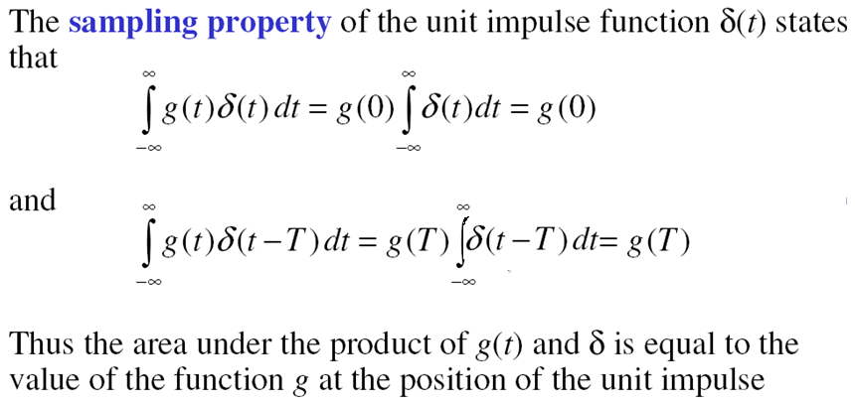
Unit Impulse Signal
Sampling (Shifting property) of the Unit impulse

Slide 10

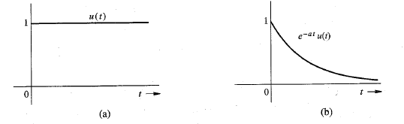
Unit Impulse Signal
Unit Step Function u(t)
If we want a signal to start at t=0, we need only multiply signal by u(t). Signal in (b)
can be described as e^{-at}u(t).

Slide 11
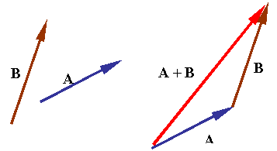
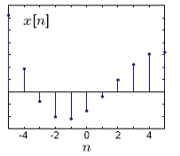
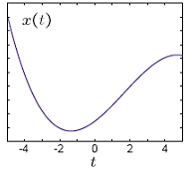
Signals versus Vectors
A Vector can be represented as a sum of its components
A Signal can also be represented as a sum of its components

Slide 12

Signals versus Vectors
A Signal defined over a finite number of time instants can be written as a Vector
Consider a signal g(t) defined over interval [a,b]
Uniformly divide interval [a,b] in N points
Where
Step Size
T₁ = a, T₂ = a+ϵ, T₃ = a+2ϵ, …. T_{N} = a+(N-1)ϵ
ϵ =

Slide 13




Signals versus Vectors
Signal vector g can be written an N-dimensional vector, where a dimension refers to the sample value at a certain time instant.
Signal vector g grows as N increases
Signal transforms into continuous time signal g(t)
g = [g(t₁) g(t₂) … g(t_{N})]

Slide 14
Signals versus Vectors
Signal transforms into continuous time signal g(t)
Continuous time signals are straightforward generalization of finite dimension vectors
Vector properties can be applied to signals

Slide 15

Signals versus Vectors
A vector is represented by bold-face type
A vector is specified by its magnitude and its direction
For example, Vector x has magnitude |x| and Vector g has magnitude | g |
Inner product (dot or scalar) of two real valued vectors ‘g’ and ‘x’ is

Slide 16
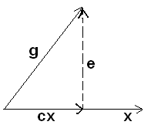
Signals versus Vectors
Component of a Vector
Consider two vectors ‘x’ and ‘g’
‘cx’ is a component of ‘g’ along ‘x’
One vector can be expressed in terms of other vector, such as g = cx + e
However, this is not a unique way of vector decomposition

Slide 17
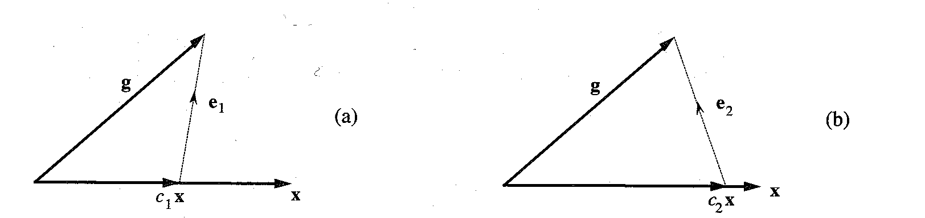
Signals versus Vectors
Component of a Vector
Other ways to express ‘g’ is
g is represented in terms of x plus another vector, which is called the error vector e

Slide 18


Signals versus Vectors
Component of a Vector
If we approximate
e = g – cx
c is used to minimize the magnitude of the error vector
Geometrically, component of g along x is |g|cosθ , which is also equal to c|x|
Hence

Slide 19


Signals versus Vectors
Component of a Vector
Based on definition of inner product, multiply both side by |x|

Slide 20

Signals versus Vectors
Component of a Vector
If g and x are orthogonal (perpendicular), then
Two vectors are said to be orthogonal (perpendicular), if their inner (scalar or dot) produce is zero.

Slide 21
Summary
Unit impulse signal
Unit step function
Signal versus vectors
Component of a vector
Vectors orthogonality

Slide 22
Thank you

